Slide 1
Augmented Shopping
Presented by:
Khedwala Maria (14CO03)
Momin Furkan (15DCO55)
Pachhapure Uzair (15DCO59)
Shaikh Samir (15DCO73)

Slide 2
Problem Statement
Several methods of providing 3D views have been proposed to overcome this problem. But the 3D views are made manually, which consume a lot of time and need experts to perform the 3D modeling.
While shopping online we can only see the screenshots i.e. images of the product. We do not get a proper idea of the shape, size, or dimensions nor can we get to see the product from different angles or views.

Slide 3
Problem Statement
The time to produce 3D model of the product should be reduced by producing it automatically rather than manually which will not take much time.
While shopping online we can only see the screenshots i.e. images of the product, so we don’t get proper idea of the shape, view and dimensions of the product.
Several methods has been proposed to overcome this problem by providing 3D view which are made manually, which consumes a lot of time.

Slide 4
Proposed work
As per the given problem in the problem statement, it is quite time consuming to generate 3D model, to overcome this problem we will be implementing the app to generate 3D model.
So through this app, time consuming process of 2 to 3 days will be done in a few minutes.

Slide 5
Also while shopping online we can only see the images these days, but the future is augmented reality a level up for every online shopping sites.
We are going to produce the 3D model of the products to give user the better understanding about dimensions and look of the product.
Literature Review

Slide 6





Basic Models
Manufacturer
App
Manufacturer
Customer
Uploads images
of product
3D model
generating
Web Site
Gets 3D model of
product from server
Admin

Slide 7
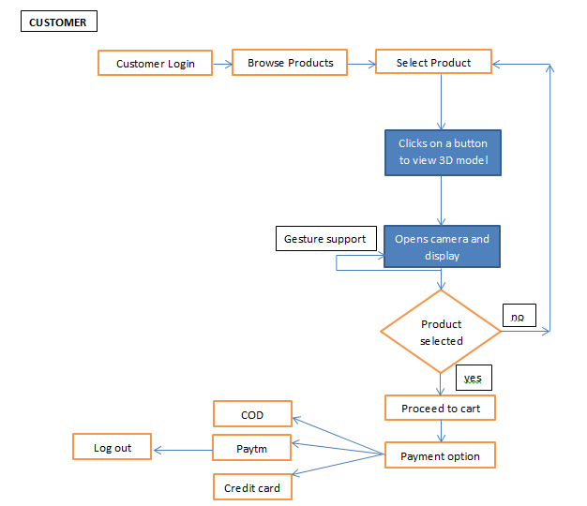

Slide 8
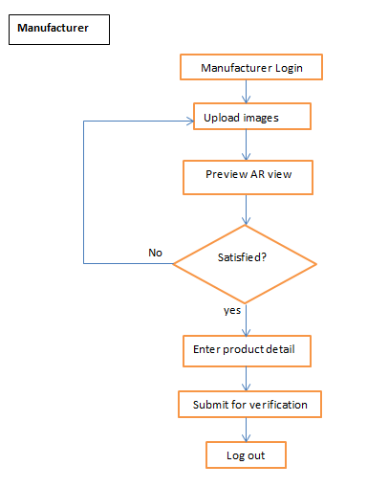

Slide 9
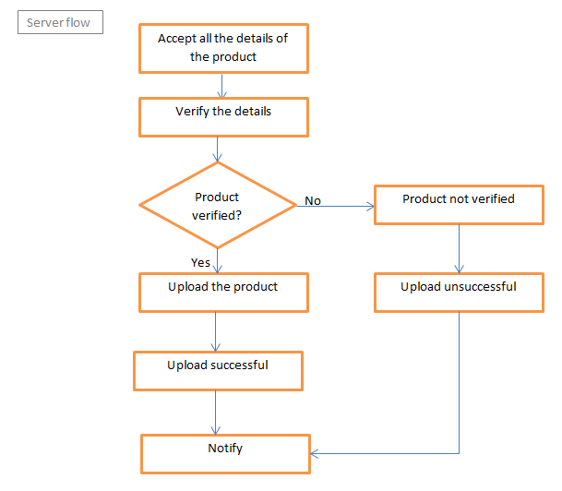

Slide 10
future Scope
In Gaming
Machine Modeling
Architectural Modeling
In Medical
E-Commerce

Slide 11
Conclusion
Our app will be able to produce 3D model of the product within a few minutes.
3D model will be generated by fastest processing algorithm.

